Slide 1
Menstruation Blood Classifier
Shri Shankaracharya Institute of Professional Management & Technology, Raipur
Major Project(Phase-I) Report on
CSE 7th Semester
Department of Computer Science and Engineering,
Batch 2019-2023
Session July – Dec 2022
Presentation Date: 24-01-23
Project Group Members:
Ghananjali Janghel
Kajal Nikunj
Mukesh Kumar Sahu
Project Guide
Mr. Devbrat Sahu
(Assistant Professor, CSE)

Slide 2
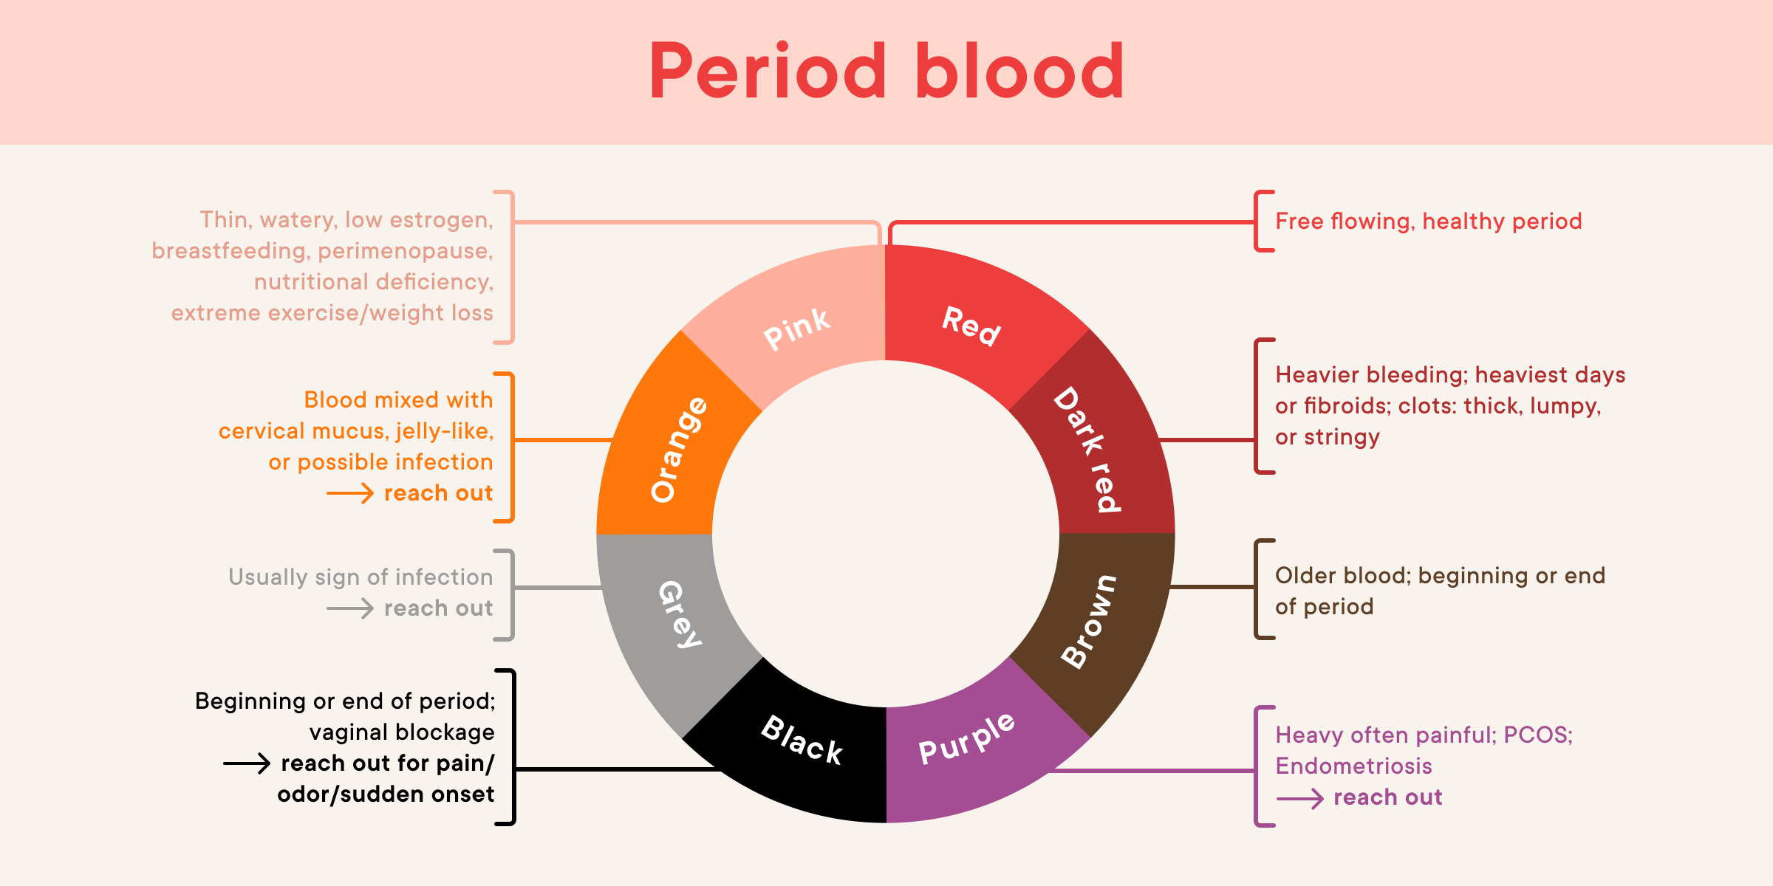
Introduction about Project
Our objective is to design a platform which configures women's health via color analysis of menstruation blood through AI and detect underlying health condition or symptoms, if any

Slide 3
Application Area
Why did you opt to work on this project?
Concerning general awareness among women regarding minor health symptoms
Normalizing Menstruation and Uplifting confidence through technological support
What are the Applications and Benefits of this project?
Color analysis through AI- Detects color (accuracy and avoids human error) and gives general analysis (positive/negative outcomes, underlying health conditions if any)
Who are the End Users of this project?
Women

Slide 4
Literature Review
Information about visual design plays a greater role in the development status of the design the. A visual communication design is basically influenced by color and image
This composition is grounded on AI technology which further aids in the development of color detection and analysis operation in design for visual media and communication
The ideal of this classifier is to design a platform which configures women's health via color discovery and analysis of period blood through AI and decry underpinning health conditions or symptoms, if any.

Slide 5
Methodology
Any color can be detected by its name, which is called color detection. In the brain, light receptors transmit signals from the eyes. And eventually our brains are capable of recognizing the colors. The result of such progression is exploring, identification and learning has been mapped into a list of colors we can associate to a range of code as well as name. This mimicked technique of human learning is used in AI as well.
Dataset: Red, green, and blue are the main colors that make up all other colors. Each color value in a computer is defined within the range of 0 to 255. There are 256*256*256 = 16,581,375 different ways to define a color. A color can be represented in roughly 16.5 million different ways. We must translate the values of each color to their corresponding names in our collection..

Slide 6
Methodology
The color detection algorithm follows the steps, directed as below:
Step 1: Procure file that contains our dataset.
Step 2: Input image from the user.
Step 3: Establish a function that determines the pixel's rgb values. The event name (x, y) equals the mouse position in the function parameters. When the event is double-clicked, this algorithm creates and modifies the r, g, and b values as well as the mouse's x and y coordinates.
Step 4: Set up the getColorName function to return the color based on the Pixel value. To determine the color name, we compute a distance(d) that indicates how near we are to the color and select the option with the smallest distance. The formula used to calculate our distance is:
Distance = pixel_value (Red – ithRedColor) (Green – ithGreenColor) ( Blue – ithBlueColor)

Slide 7
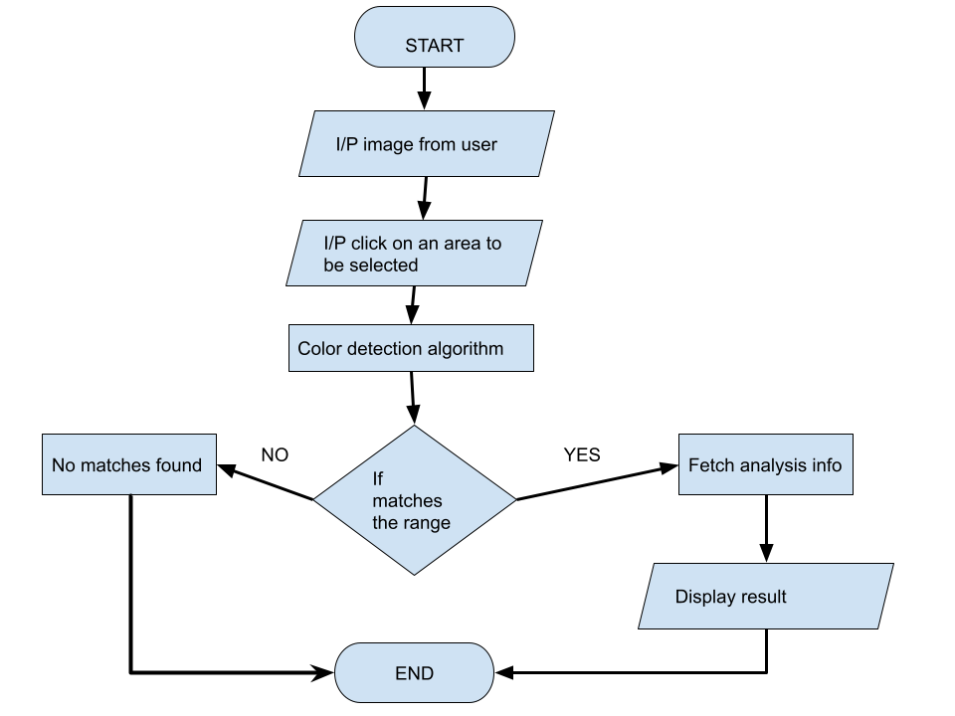
Project Work Flow Diagram

Slide 8

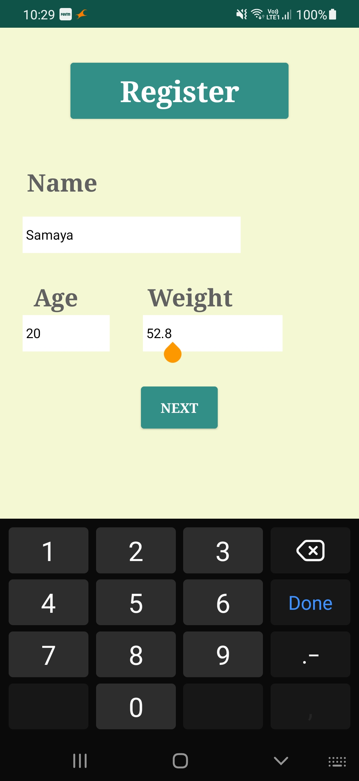
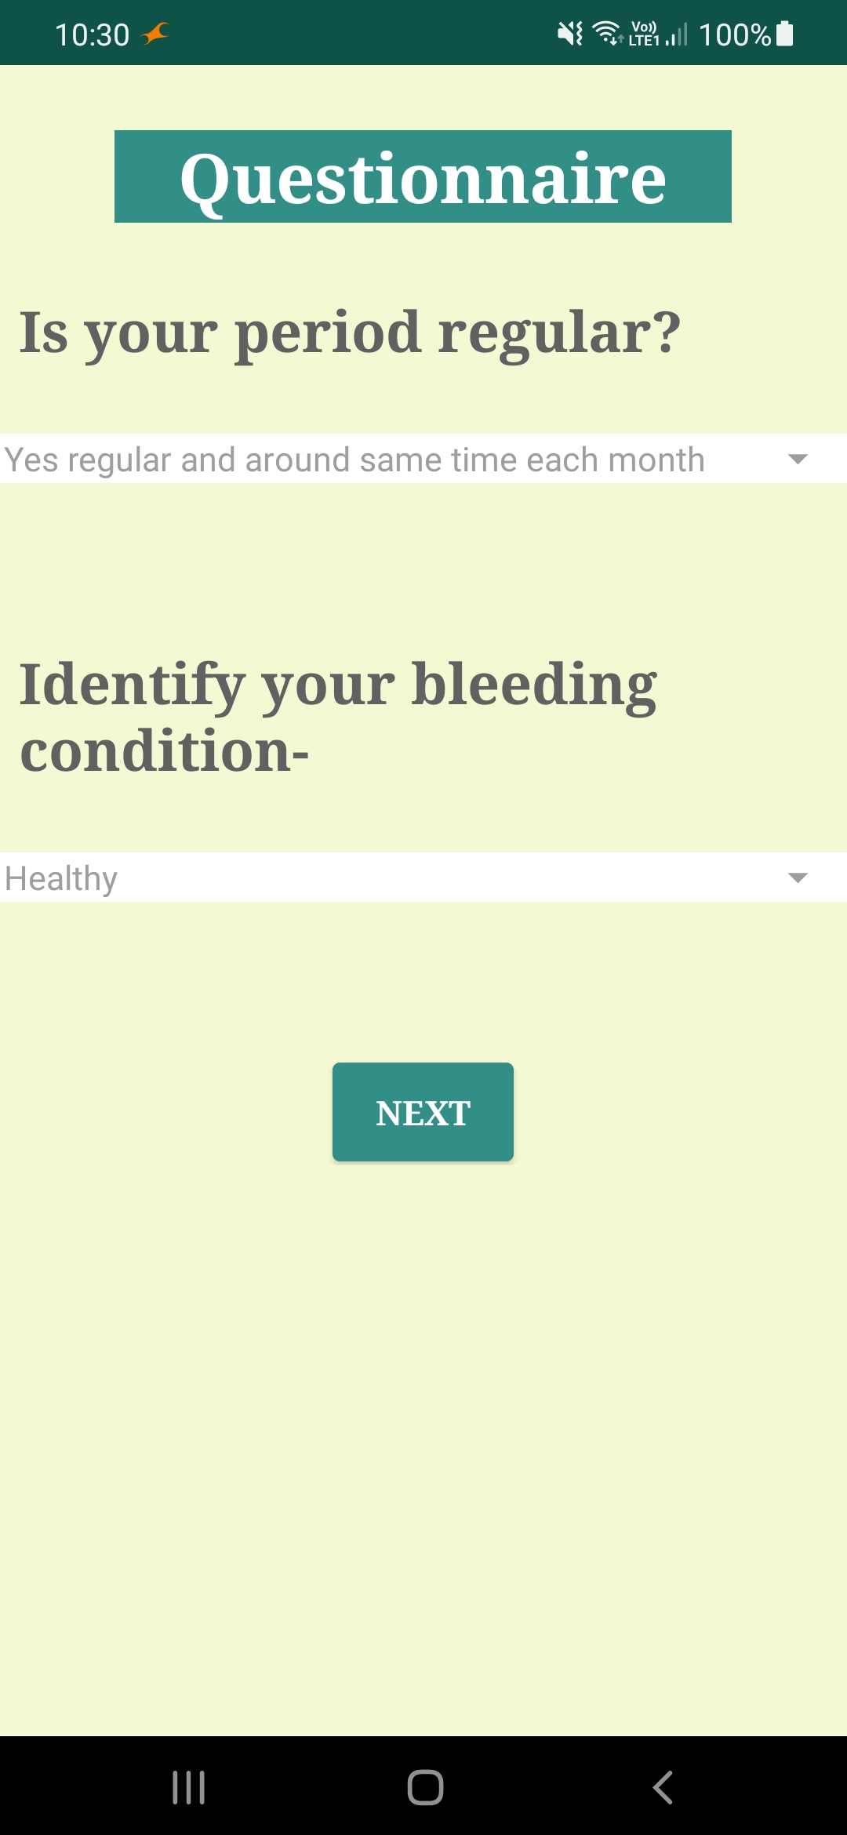
Result & Conclusion
Shows your Project outcomes
Snapshot with description
1. Display Logo
2. Registration
3. Questionnaire

Slide 9
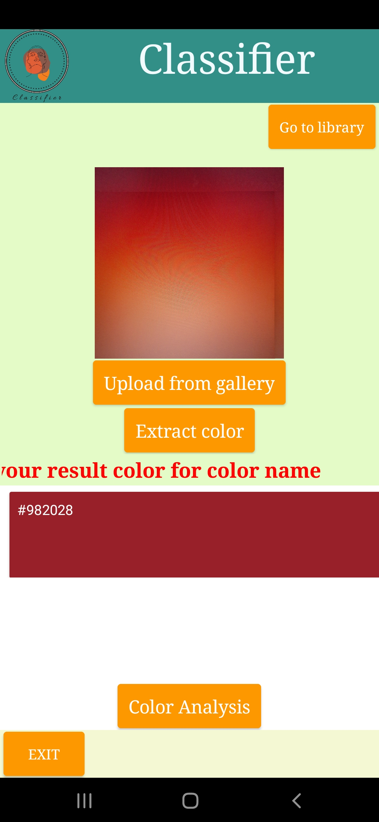
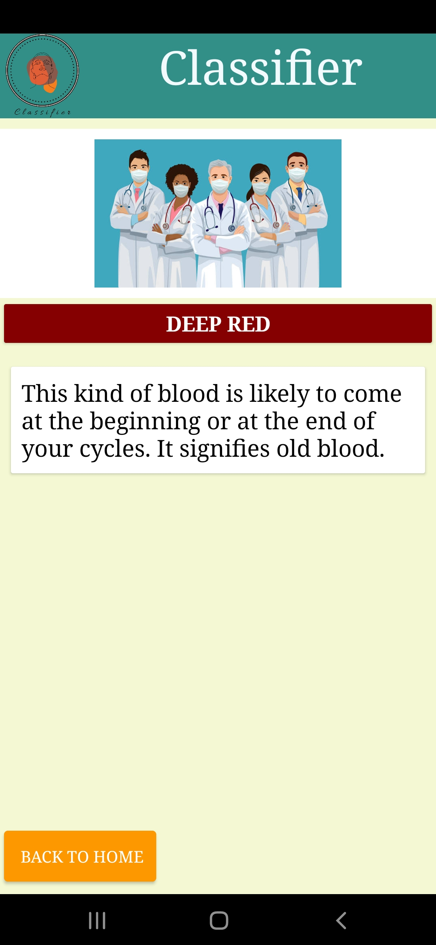
4. Upload Sample
5. Color Analysis with some precautions

Slide 10
References
Web Resources :
https://www.themedicalmassagelady.co.uk/general-information/general-wellbeing/what-does-the-colour-and-texture-of-your-menstrual-blood-mean
https://www.medicalnewstoday.com/articles/324848
https://data-flair.training/blogs/project-in-python-colour-detection/

Slide 11
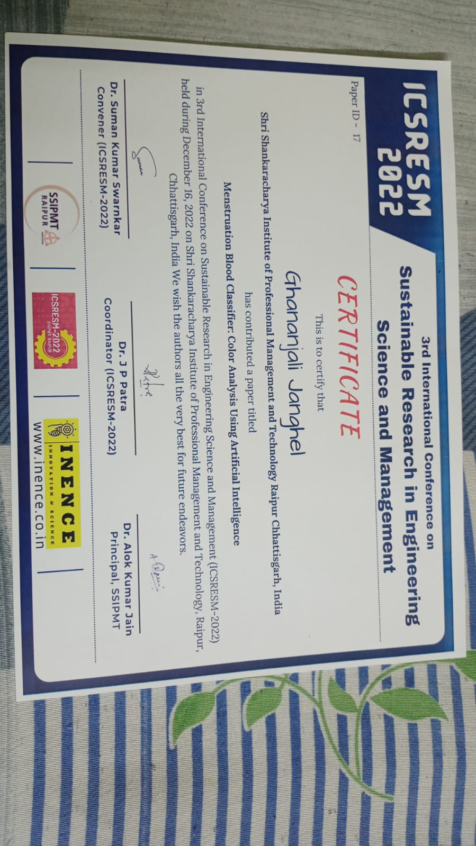
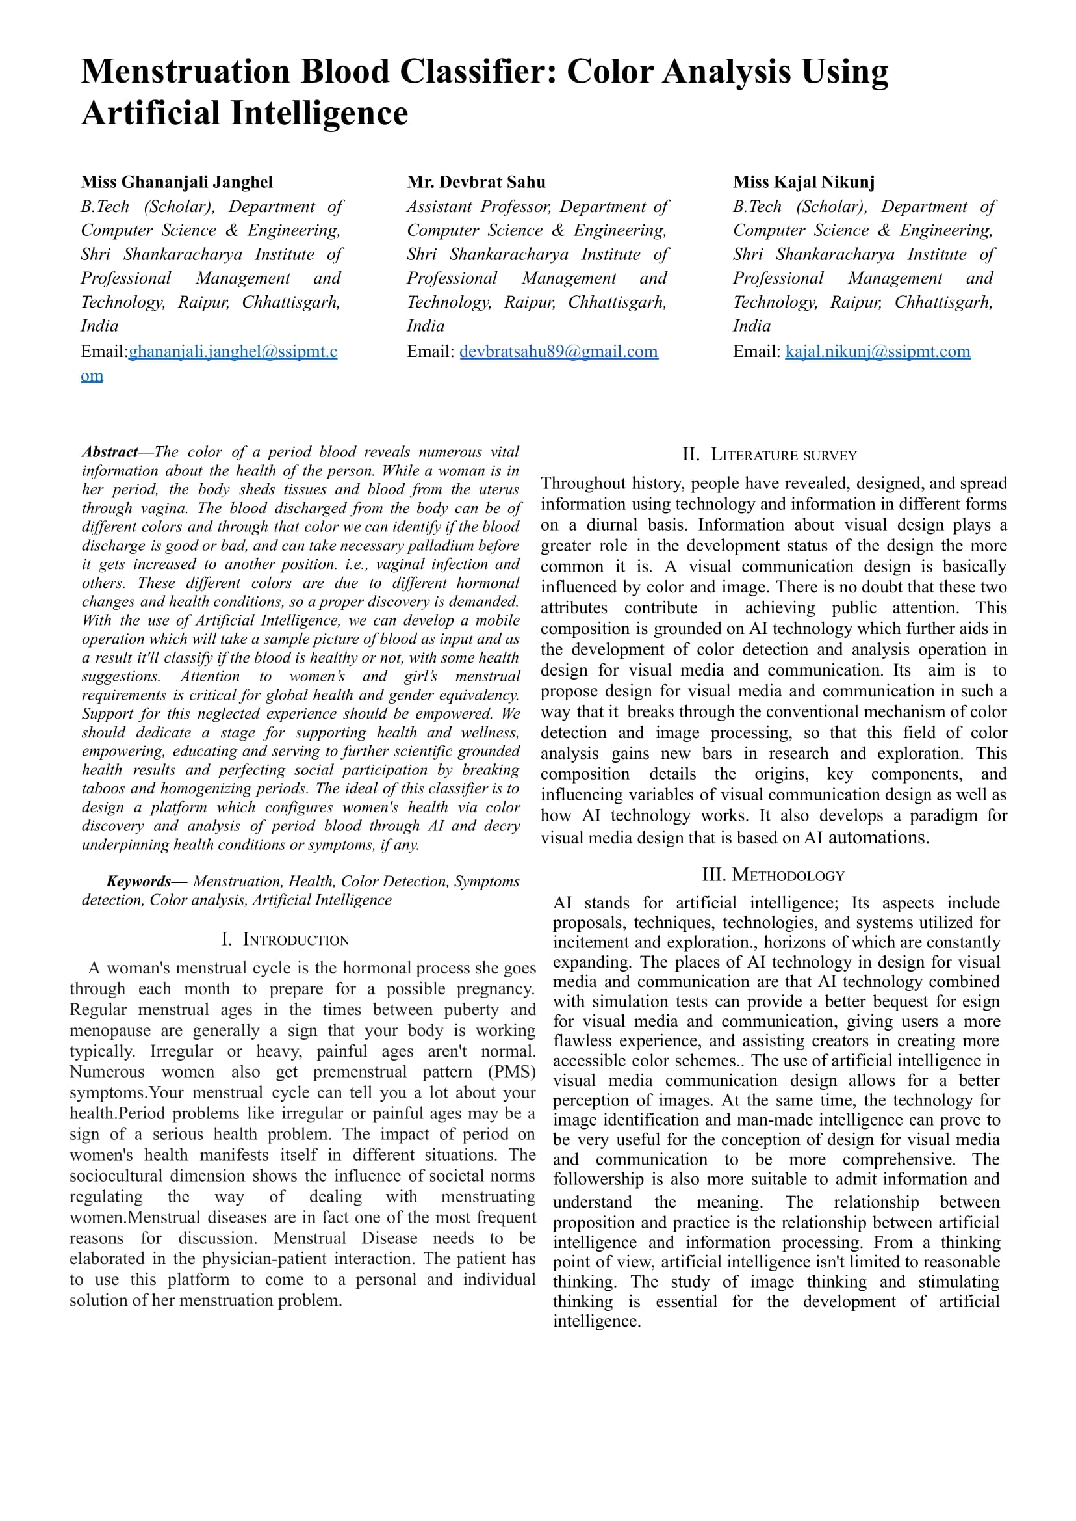
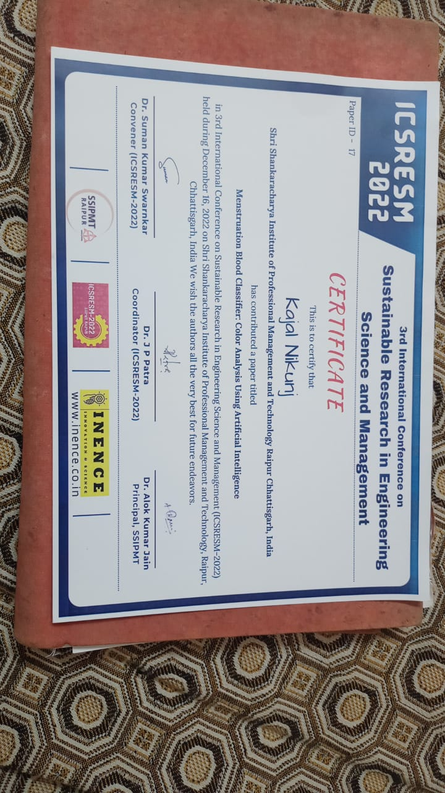
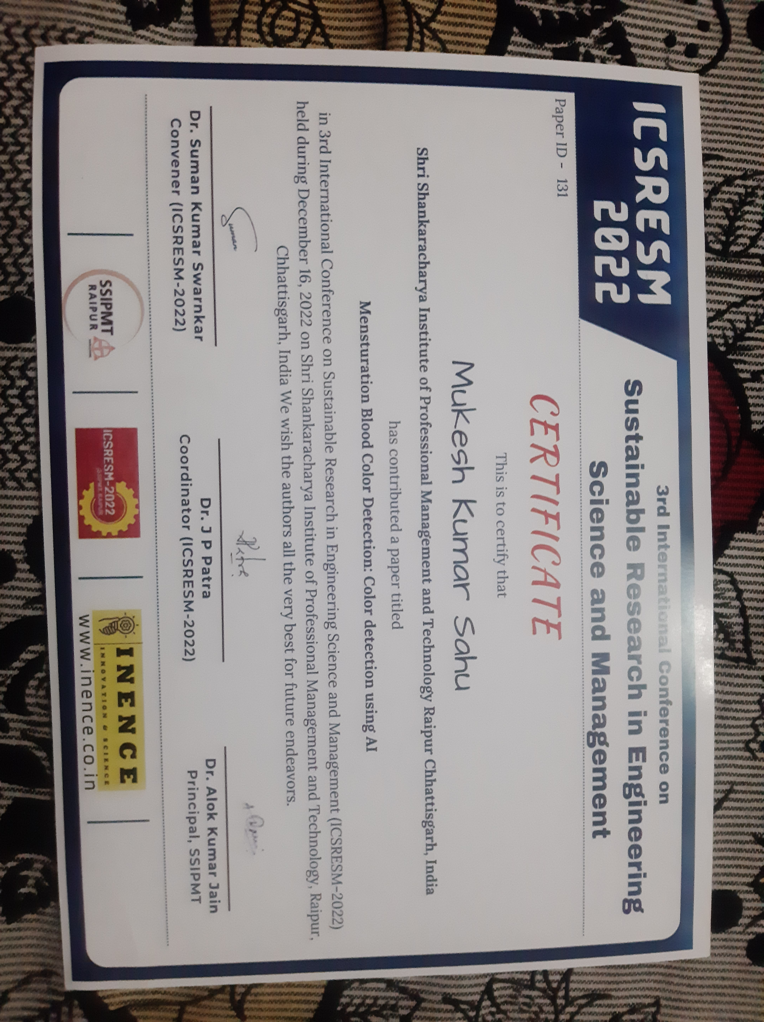
Paper Publication Details
Paper Publication Certificate

